Slide 1

Facebook Data Exploratory Analysis
Team Member Name: Sneha Godbole
Email id: snegodbo@umail.iu.edu

Slide 2
Agenda
Introduction / Motivation
Relevant Existing Work
Hypothesis and Research Questions
Dataset Details
Implementation Approach & Techniques
Data Preprocessing
Implementation Techniques Details Per Insight
Tools & Technologies
Results & Insights
Conclusions

Slide 3
Introduction / Motivation
As these networks grow and mature, users have been observed to form hundreds to even thousands of friendship links.
Interesting / Motivational Questions
I have ~800+ active friends on Facebook.
Do I interact with all of them often? How often?
Are all of them my best friends?
Do I “just know” some of them? How are my ties with all of them?

Slide 4
Introduction / Motivation
What is Connection network?
A connection network is a network graph based on Facebook connections among given set of users.
What is Activity network?
An activity network is a network graph based on Facebook wall interactions of a given set of users, within given timelines.
Interesting / Motivational Questions
How would be the activity network for me, and what would be the properties of such networks compared to connection network?
I would love to get these insights as if this is my real friends network !

Slide 5
Relevant Existing Work
An interesting research paper and literature review which gave me an aspiration is available @ https://icon.colorado.edu/#!/networks , under Social network domain category, named Facebook Wall Posts 2009.
A research paper named "On the evolution of user interaction in Facebook”, published in WOSN’09, August 17, 2009, Barcelona, Spain, is available @ http://www.mpi-sws.org/~gummadi/papers/wosn23-viswanath.pdf .
The paper finds that links in the activity network tend to come and go rapidly over time, and the strength of ties exhibits a general decreasing trend of activity as the social network link ages. For example, only 30% of Facebook user pairs interact consistently from one month to the next.
Interestingly, the paper also finds that even though the links of the activity network change rapidly over time, many graph-theoretic properties of the activity network remain unchanged.

Slide 6
Hypothesis and Research Questions
The working hypothesis for my work was I should be able to validate the research and literature survey published in http://www.mpi-sws.org/~gummadi/papers/wosn23-viswanath.pdf paper.
The implementation should lead to interesting exploratory analysis and I should get some meaningful insights from the friendship as well as activity network.
Research Questions / Potential Insights targeted to be found out –
Get insight on most popular user in activity network.
Get insight on most active user in activity network.
How are number of wall post per month/year by all the users.
Validate Clustering Coefficient & Degree Distribution of connection graph.
What is rate of interactions over time among users.
How are number of wall post per year by all the users.

Slide 7
Data Source Details
Potential Data Sources
The dataset which was used for this research work and validating it by implementation, is available at http://konect.uni-koblenz.de/networks/facebook-wosn-wall and http://socialnetworks.mpi-sws.org/data-wosn2009.html links, and used same dataset for my validations as well as experiments.
I verified the datasets and it looks good to me in terms of activity and connection network information.

Slide 8
Implementation Approach & Techniques
Potential Insights / Exploratory Analytical Results Found
Most popular user in activity network.
Most active user in activity network.
Number of wall post per month/year by all the users.
Clustering Coefficient & Degree Distribution of connection graph.
Rate of interactions over time among users.
Number of wall post per year by all the users.

Slide 9
Implementation Approach & Techniques
Data Preprocessing Steps
As a requirement of doing exploratory analytics by year / month / date level, I standardized all the timestamp values in the given dataset into “yyyy-mm-dd” format. This was achieved by implementing a custom function and using it on entire dataset.
I used step #1 to populate two extra columns namely “year” and “month”, for each row in a given dataset.
Result of steps #1 and #2 was stored in the form of DataFrame and was used for all further analytics / insights exploration.

Slide 10
Implementation Approach / Methods
Most popular user in activity network.
I analyzed the activity network, and got insight on a most popular user/s based on “most number of incoming Facebook wall interactions”.
This was implemented by writing a custom function using preprocessed dataset as an input, and generating popular user/s as an output in a chart.
I plotted this pattern on a bar chart and the observations are present in following section.

Slide 11
Implementation Approach / Methods
Most active user in activity network.
I analyzed the activity network, and got insight on a most active user/s based on “most number of Facebook wall interactions initiated by a user”.
This was implemented by writing a custom function using preprocessed dataset as an input, and generating active user/s as an output in a chart.
I plotted this pattern on a bar chart and the observations are present in following section.

Slide 12
Implementation Approach / Methods
Number of wall post per month/year by all the users.
I used the timestamp of wall posts for a given set of users, to examine the growth of user interactions over time by analyzing wall interactions for all users.
I then categorized the interactions every month in an year (for all given years)
The insight here is a pattern of activity rate over the period of time.
I plotted this pattern on a line chart and the observations are present in following section.

Slide 13
Implementation Approach / Methods
Clustering Coefficient & Degree Distribution using standard graph theory / network science methodologies.
I transformed given connection dataset into a Graph, by mapping source and target to graph nodes and represented the connection as an corresponding edge.
Using graph prepared in #1, I used networkX functions to implement clustering coefficient & degree distribution statistics.
I plotted the degree distribution on a graph, and I observed that it follows power law distribution.

Slide 14
Implementation Approach / Methods
Rate of interactions over time among all users.
I analyzed the activity and connection network to figure out how does the rate of interactions varied over time, since the users got connected to each other.
Data Sampling
In order to meet processing time / computing requirements (using my single node laptop for execution), I sampled 1000 connections from given connection dataset.
I then populated appropriate activity dataset for these 1000 connections.
Then I analyzed the connection time & wall interactions information, to find a pattern on how does the rate of interactions varied over time.
The pattern was categorized based on year.
I plotted this pattern using bar chart, and the results are available in following section.

Slide 15
Implementation Approach / Methods
Number of wall post per year by all the users.
I used the timestamp of wall posts for a given set of users, to examine the growth of user interactions over time by analyzing wall interactions for all users.
I then categorized the interactions every year.
The insight here is a pattern of activity rate over the period of time.
I plotted this pattern using line chart and the result is available in following section.

Slide 16
Implementation Approach / Methods
Tools & Technologies
I used following tools and technologies for the implementation –
Python
Panda Libraries
MatplotLib
Jupyter Notebook

Slide 17
Results & Insights

Slide 18
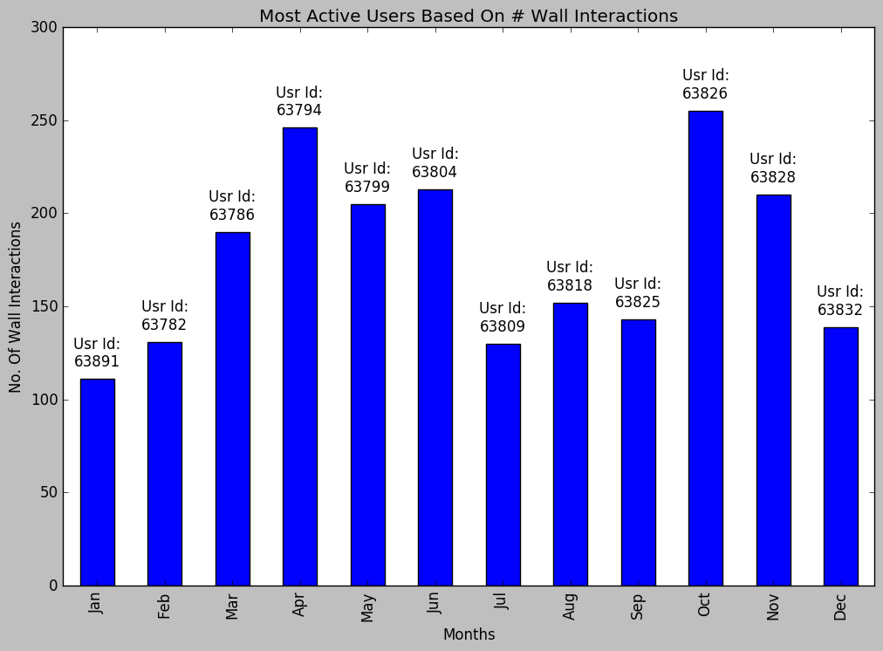
Most Active Users Per Month in 2008
Most active user is
USER ID : 63826

Slide 19
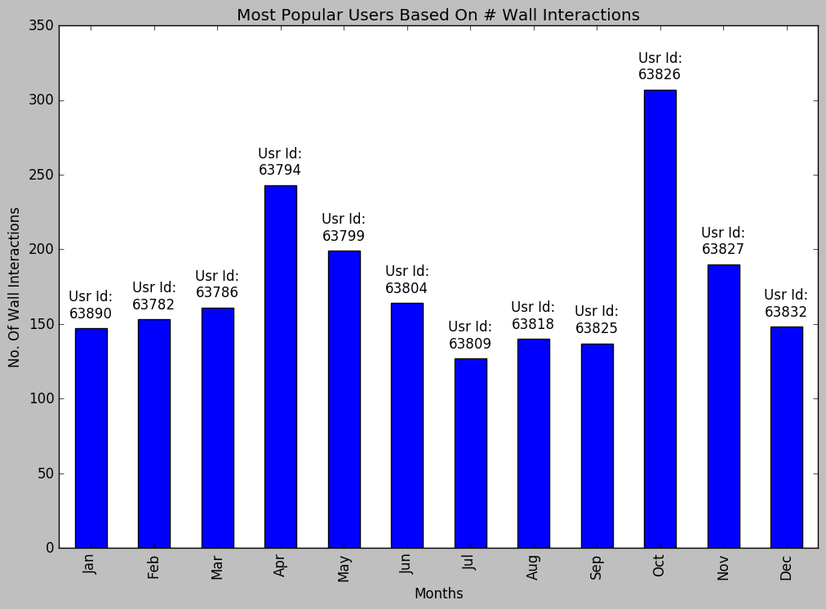
Most Popular Users Per Month in 2008
Most popular user is same as most active !
USER ID : 63826

Slide 20
Most Active & Popular Users
Key Insights Found
If we closely see the most active and most popular users graph, we see that many “most active” users are “most popular” and vice versa. This is correct as active users are popular, and popular users are active.
In 2008, based on activity network, total interactions happened are ~250.
In 2008, based on activity network, total maximum incoming wall interactions per user is ~300.

Slide 21
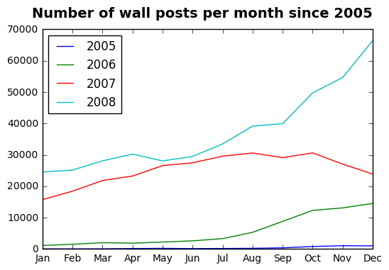
Number of wall posts per Month per Year
The rise of wall posts in 2008 is because of new Facebook Design Launch !
Very less activities during 2005 !

Slide 22
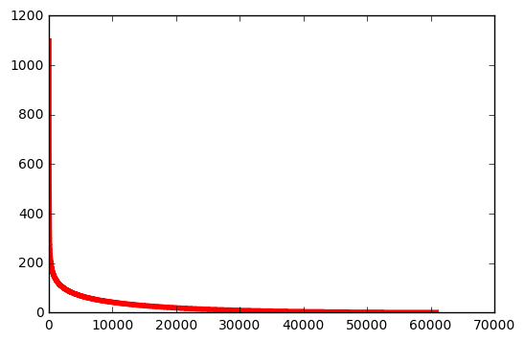
Degree Distribution of a Connection Network ! follows power law distribution !

Slide 23
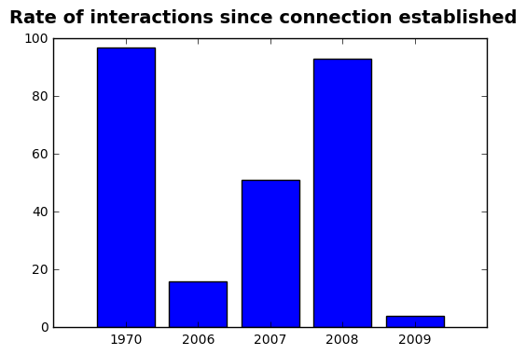
Rate of Interactions since Connection
Highest interaction rate is in 1970
Sudden Interactions
Increase
Least interactions is in 2009
No interactions between 1970 to 2006

Slide 24
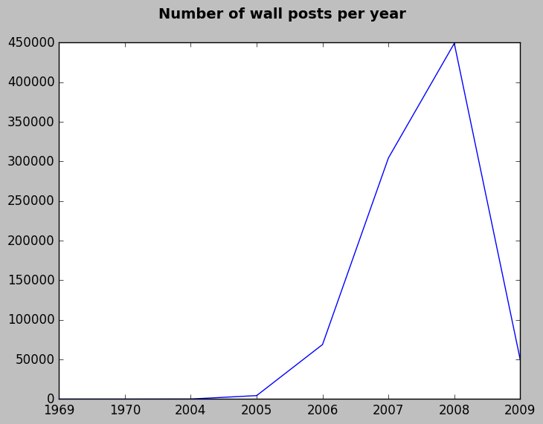
Number of Wall Posts Per Year
Highest #Wall Posts during 2007-2008 !!

Slide 25
Conclusions & Future Work
I could successfully implemented, and verified most of the research work, insights and literature survey published in http://www.mpi-sws.org/~gummadi/papers/wosn23-viswanath.pdf paper.
The implementation led to interesting exploratory analysis and I got many meaningful insights from the friendship as well as activity network. I found the overall end to end experience very exciting and interesting. I could relate network science academics with the real use cases after this successful implementation.
One of the future work item could be to implement and validate remaining insights proposed in the referred paper / research work.
Another future work item could be to apply these explorations and techniques to my Facebook connection and activity graph and find the interesting patterns / insights!

